Slide 1
East African Trade Union Confederation Workshop-Zanzibar
Publish What You Pay: Branding Value Chain-Extractive Industries Transparency and Accountability

Slide 2
Overview of Presentation
Extractive Industries Issues and Status: Africa
History and Essence of PWYP
EITI: Essence and What It Entails
Extractive Industries Status: Tanzania
PWYP-Tanzania Coalition
Tanzania TEITI First Reconciliation Report: Key Issues
Moving Away from Transparency to Accountability
Way Forward: EATUC

Slide 3
Extractive Industries Issues and Status: Africa
The Resource Wealth of Africa
The rate of discovery of new oil reserves has been the greatest in The gulf of Guinea over the past eight (10) years. The region hold an estimated 10% of the World’s total oil reserves
Most African countries are among the world richest countries in natural resources (Gold, Oil, Diamond,…)
For example in Ghana is currently 2nd in Africa and 10th in the world in gold production and exports; Tanzania is the 4th Gold producer in Africa.
The oil production of Nigeria is 2.5 millions barrels per day. The largest in Africa.
Chad is abundant in salt, uranium, gold, diamond, kaolin and crude oil. The country produces around 400,000 barrels per day
Gabon holds largest oil reserves in SSA

Slide 4
Extractive Industries Issues and Status: Africa
Mauritania has started producing 75,000 barrels per day
Cameroon is the 5th largest producer in Sub-Saharan Africa with 82.300 barrels per day
Sierra Leone have large deposits and produces the finest rough diamonds in the world
Mozambique holds large reserves in natural gas
One of the reasons of the war in Liberia and Sierra Leone is the desire to control the abundant diamond, gold and other natural resources
Uganda is about to embark on Hydrocarbons production.

Slide 5
Extractive Industries Issues and Status: Africa
The EIs Wealth vis-à-vis Poverty: Paradox
There is wide spread Poverty IN Extractive resource endowed countries (Resource curse)
Most Countries are Highly Indebted Poor Countries
Scores low on the Human Development Index
Deepening Poverty particularly in mining communities
Deepening environmental degradation and depletion of rural communities sources of livelihoods
Growing incidence of human right abuses

Slide 6
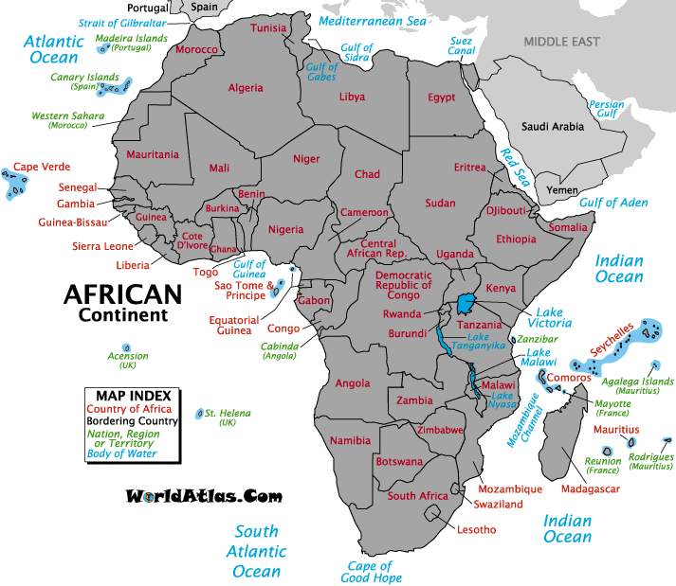
Status: Widespread Resources and Poverty
There is consensus that the extractor sector in its present form and character enforces poverty rather than reducing it
There is consensus that the sector in present form fuels conflicts, engenders human right violations and promotes gross equality.
Major stakeholders in the extract sector have evolved initiatives/ processes in reaction to these criticisms
- About 12 mineral dependent countries as well as 6 oil dependent counties in Africa went HIPC and had the worst human development indicators with most of civil conflicts between the 1990s and 2004 (WB).
These include Nigeria, Sierra Leone, Chad, Gabon, DRC and Ghana. Liberia, Senegal and Guinea Bissau experience similar problems in the production of other valuable natural resources such as timber, fish, and cashew nuts.
Broadly, there are four problems facing these countries:
domestic governance problems- effective & efficient utilization of resources (including the mismanagement and corrupt use of revenues, reflecting poor quality budget processes and budgetary outcomes)
regulatory problems- obligations of extractive companies, including transparency of what they pay as revenues to government relative to what they earn and retain;
terms of trade problems facing commodities, as reflected in price volatilities and trend declines,
environmental and social problems related to the extractive processes.

Slide 7
History and Essence of PWYP
By Industry, Government & IFIs
These resulted as response to civil society networks and alliances’ critical voices – AIMES, GMC. Mines and communities,
The industry and Financial Institutions and Government has initiated a number of initiatives with it bid to ensuring good corporate governance
- the World Business Councils on Sustainable Development (WBCSD) tracts the corporate sector to ensure corporate greening
- the Global Mining Initiative, the mining sector derivative of the WBCSD promotes social corporate responsibility and good corporate governance with a variety initiative MMSD, Voluntary Codes, partnerships, cyanide code etc.
The WGB initiated the Extractive Industry Review Process (EIR) and guidelines for mining environmental management
IMF Guide on Resource Revenue Transparency
Partnerships: Kimberly process(2003) & EITI(2002)
By Civil Society - Strong reaction from local communities and civil society groups
Communities Affected by extractive industry
Mines and communities, Global mining Campaign
African Initiative on Mining Environment and Society (AIMES)
International Financial Reporting standards for the extractive sector
Core Labour Standards for extractive industries etc
Kimberley Process, No dirty (gold and Diamond campaigns)
Publish what you pay (PWYP) campaign

Slide 8
History and Essence/…PWYP
Founded in 2002 by Global Witness, Open Society, CAFOD, Save the Children UK, Transparency International among others
Now more than 300 members from over 50 countries
Members sign up to general appeal and agree to broad membership principles
Work as coalition – both nationally and internationally – to pool together collective strengths, resources, contacts and common objectives under one umbrella
PWYP is a campaign, not an organization
3 Permanent staff (Int’l Coordinator, Africa Coordinator, Information Officer) ensuring general coordination, working closely with member NGOs and national coalitions
Global Governance structure: SAG, multiyear action plan, regular regional and global strategy meetings - emphasis on development of national civil society coalitions to ensure local ownership and independence

Slide 9
History and Essence/…PWYP
Four-fold:
1) Publish What You Pay, Earn, Spend ,or Should Have Paid
Revenue transparency (old concept) to be incorporated into international norms and standards

Slide 10
History and Essence…/PWYP
Coalitions
Indonesia
Australia
Azerbaijan
Kazakhstan
Kyrgyz Republic
Georgia
South-East
Asia / Aus
Working through
Advocacy
Monitoring
Representation
Networking
Capacity building
United States
Canada
America
Central Asia
PWYP
International
Chad, Cameroon
Congo Brazzaville
DR Congo, Ghana
Liberia, Mauritania
Nigeria, Sierra Leone, Niger
Guinea, Guinea Bissau, Cote d’Ivoire, Mali, Mozambique, Burkina Faso, Zambia, Uganda, Gabon, Tanzania, Zimbabwe, Madagascar, Togo, Senegal, (Kenya) and (Malawi)
France
Germany
Netherlands
Norway
United Kingdom
Europe
Africa

Slide 11
PWYP-Tanzania Coalition
Efforts started way back 2003
Information workshop conducted 2009,
Choice on focus areas; oil, gas, minerals, forestry (wildlife inclusive) and forestry resources
Launch April 2010
Current membership 60
Hosted at ForDIA, functioning through the Governance structure of
AGM
Steering Committee
Technical working Groups
Research & Advocacy (NCA)- over 6 members
Training & Capacity Building (LHRC) - over 6 members
Coordination, M & E - ForDIA
2010 funded focus areas; oil, gas, minerals. Those not funded focus areas are forestry (including wildlife and fisheries)
2010 work plan focus, research, training and advocacy
Activities accomplished so far; research on CSR (Geita case study), TV talk shows, members’ training (rescheduled to January 2011)
Governance documents: MoU and regulations

Slide 12
PWYP Coalition-Tanzania/Funding
Funds to implement PWYP-T coalition programme activities were received from:
Revenue Watch Institute (RWI) - since 2009,
The Open Society Initiative for Eastern Africa (OSIEA) - since 2010.

Slide 13
PWYP-Tanzania Work-Plan
a) PWYP Campaign Launch
Identify, mobilise, and recruit at least 50 PWYP-T active members from
small scale miners and/or community groups in mining areas,
environmental groups,
journalists,
researchers and
policy analysts
Post launch media campaign: TV and radio slots on CSR & role of MPs in EI revenue transparency
Roundtable discussion: the new miming bill and policy

Slide 14
PWYP-Tanzania Work-Plan…/
Roundtable discussion: EI contract transparency in Tanzania.
Roundtable discussion: Tanzania EITI process and what to expect
Website design and launch
b) Capacity building to inculcate knowledge, skills and experience in Extractive Industries (training Seminars and Study trips) involving PWYP-T members
Compile EI Knowledge Manual
Training on EI issues (extraction, down stream/upstream operations, EI value chain/revenue stream, EI legal and regulatory regime/framework, EI revenue fiscal policy, CSR and study visits

Slide 15
PWYP-Tanzania Work-Plan…/
c) Conduct study and disseminate information on:
Oil and Natural Gas resource availability situation in Tanzania
Impact of mining on growth in Tanzania
Study reports presentation to Parliamentary Committees (3): PAC, Minerals and Energy and Natural Resources and Environment
Printing and publishing (dissemination) of (1-2) study reports

Slide 16
PWYP-Tanzania Work-Plan…/
d) Enhance public engagement in EI transparency
Roundtables and media coverage to discuss study findings in 1-2 above, focusing on the new mining bill and policy, effect of EITI, contract transparency, legal and fiscal regimes, environment and human right issues, CSR, and role of MPs and Parliament to oversee EI revenue transparency and accountability.
e) Conduct internal review of PWYP-T performance during 2010
Develop a three year PWYP-T Coalition strategic plan

Slide 17
Challenges and Forward Plans
Institutional building support
There is need for more staff, equipment and funding.
So far PWP-T has 2 fulltime staff (programme officer and assistant programme officer).
PWYP-T Coalition Coordinator is overall in-charge of coalition governance.
The coalition is properly fitted into the 2011-2015 strategic plan of ForDIA, which is likely to ease coalition separate efforts to fundraise.
The coalition coordinator was during Africa regional Meeting of PWYP in May (Kinshasa) elected member of PWYP Africa regional Steering Committee representing the Eastern and Southern Africa sub-region. This posses is another stretch challenge to human and funding resources.

Slide 18
Challenges and Forward Plans
Expanding PWYP-T campaign focus and strategy
The coalition campaign should accommodate, other than oil, gas and minerals, forestry (inclusive of wildlife) and fisheries resources as earlier decided by members.
Planning and execution of corresponding strategic activities, including:
baseline studies,
analyses,
campaign design,
networking and
public mobilisation to promote transparency and accountability in the fisheries and forestry sectors are looked forward.

Slide 19
Challenges and Forward Plans
3. Expanding media campaign (documentaries inclusive) and strategic engagement with key stakeholders including state institutions (Parliament, and Local Government Authorities during their respective formal meetings) has become imperative.
Implications of the country candidacy to EITI,
effective engagement in the on going global advocacy/debate for expanding EITI beyond receipts and payments entries reconciliation so as to accommodate contract transparency,
equitable revenue redistribution,
social and environmental impact, and
community benefits which dictate that PWYP-T coalition must act quickly if it has to remain relevant.
Moreover, during the next 2 years PWYP-T coalition will be fully involved in the tasks of pioneering and/or promoting PWYP campaign in Eastern and Southern Africa sub-regional countries.
Learning and strategic experience sharing, solidarity or capacity building sessions across countries in the sub-region are envisaged.

Slide 20
Challenges and Forward Plans
Conduct Tanzania EITI report analyses; community outreaches, dissemination of, and coordination of community feedback views.

Slide 21
Extractive Industries in Tanzania: Issues
Extractive Resources Abundance in the Country
World number one producer of Tanzanite.
4th Africa producer of Gold after South Africa and Ghana and Mali, followed by Burkina Faso
Availability of natural gas, (oil exploration continues), diamond, uranium, titanium, nickel, iron ore.
Inadequacy of
Mining policy of 1997 [2009 does not intend to empower public but to facilitate administration/Govt.]
Mining Act of 1998 [2010 there are still, unresolved issues around ownership, compensation, but the overall vision]
Petroleum Act 1980/2008
Energy Policy 1992 (revised 2003) – Mainland only, not in Zanzibar.
No policy and law for gas
No policy and law for Corporate Social Responsibility (CSR)

Slide 22
Extractive Industries Status: Tanzania
Extractive Resources Abundance in the Country
World number one producer of Tanzanite (12.6 tons of proven reserves)
4th Africa producer of Gold (2,222 tonnes of proven reserves) after South Africa and Ghana and Mali, followed by Burkina Faso.
Availability in plenty of
natural gas; 4 site reserves in Kilwa, Lindi, Mnazi Bay, Mtwara, and Mkuranga Coast - total proven reserves; 60 TCF (oil exploration continues),
Gold: 2,222 tons
Diamonds: 50.9 million carats
Tanzanite: 12.6 tons
Copper: 13.65 million tons
Nickel: 40 Million tons
Coal: 1.5 Billion tons
Uranium: 35.9 million pounds

Slide 23
Extractive Industries Status: Tanzania
Current EIs Investment in Tanzania
By 1996 World Bank had advised, and actually supported the Government to introduce large scale mining [formulation of mining policy 1997 and Mining Act 1998].
Since 1994, more than 50 multinational companies and 250 local companies have acquired mineral rights.
US$2.5bn of foreign direct investment in the past decade in the EIs sector
extractive sector employs 1% of wage earners with between 400,000-600,000 small-scale miners inclusive; and 13,000 being formally employed in the sector
Overly persistence of rudimental small scale mining

Slide 24
Extractive Industries Status: Tanzania
Company name | Country of Origin | Area/Block
Antrim Resources | Canada | Zanzibar/Pemba
Artumas Group | Canada | Mnazi Bay
Dominion Oil & Gas | UK | Mandawa, Kisangire, Selous & Deep Sea Block#7
Dodsal Resources | UAE | Ruvu Block
KEY PETROLEUM | Australia | West SongoSongo
Mauriel ET Prom | France | Bigwa & Mafia Channel
Ndovu Resources/Tullow Oil | Australia | Nyuni, Ruvuma
Ophir Energy | Australia | Deep Sea Block#1,3,&4
Pan African Energy | UK | SongoSongo
Petrobras | Brazil | Deep Sea Blocks#5,6 &

Slide 25
Extractive Industries Status: Tanzania
Petrodel Resources/Heritage | UK | Tanga, Kimbiji & Latham
RAK-GAS Company | UAE | East Pande
SHELL International | Holland | Deep Sea Blocks#9,10,11,&12
STATOILHYDRO ASA | Norway | Deep Sea Block#2
HYDROTANZ | UK | North Mnazi Bay
TULLOW OIL | UK | North Lake Tanganyika
BEACH PETROLEUM | AUSTRALIA | South Lake Tanganyika

Slide 26
Extractive Industries Status: Tanzania
Company name | Country of Origin | Area of Projects Operations
Africa Barrick Gold | Canada | Mara, Shinyanga, Kagera
Resolute Mining | Australia | Tabora (Nzega)
Petra Diamond | South Africa | Mwadui Shinyanga
Mantra Resources & ARMZ | Australia & Russia | Morogoro (Selous), Dodoma, Singida and Tuvuma
Tanzania One | South Africa | Mererani, Manyara
Anglo Gold | South Africa/UK | Geita/Mwanza
El Hillal Minerals | Tanzania | Mwadui/Shinyanga

Slide 27
Extractive Industries Status: Tanzania
Petroleum Act 1980/2008
Energy Policy 1992 (revised 2003) – Mainland only, not in Zanzibar.
No policy or law to regulate gas exploration, extraction and distribution; regulated by energy policy, TPDC Act and Production Sharing Agreements (PSAs)
Invisibility of local investors competitively investing in EIs.
Overly capital flight versus Tanzania Foreign Exchange Reserve Deficit (holes in the law)
Revenue Stream predominantly workers income tax and Royalties.
Excessive Tax Incentives to EIs Investors.
Relatively low contribution to real GDP (3.4%; 2009)
Significant export (foreign exchange) earner
Dominated by Gold and Diamond extraction
Unresolved issues around ownership, compensation, and the overall vision

Slide 28
Extractive Industries Status: Tanzania Contribution of Mining Sector as Percentage of GDP (1990 as base year)
Year | Value (%of GDP) | Year | Value (%of GDP)
1988 | 0.80 | 1999 | 2.00
1989 | 1.80 | 2000 | 2.4
1990 | 0.91 | 2001 | 2.50
1991 | 1.00 | 2002 | 2.81
1992 | 1.12 | 2003 | 2.89
1993 | 1.12 | 2004 | 3.12
1994 | 1.30 | 2005 | 3.26
1995 | 1.38 | 2006 | 3.3
1996 | 1.50 | 2007 | 3.45
1997 | 1.70 | 2008 | 3.6
1998 | 1.91 | 2009 | 3.4

Slide 29
Extractive Industries Status: Tanzania Mineral Production Composition by major types, 1999 -2008
Type of Mineral | Percentage Contribution in %
Gold | 90.68
Silver | 0.33
Copper | 1.49
Diamonds | 6.40
Tanzanite | 1.10
Total Contribution | 100.00

Slide 30
Extractive Industries Status: Tanzania General and Mineral Exports in %
 | 2003 | 2004 | 2005 | 2006 | 2007 | Averages
Mineral exports as % of total exports
Gold exports as % of total exports | 41.3 | 42.7 | 39.1 | 45.3 | 38.0 | 41.3
Diamond as % of total exports | 2.4 | 1.8 | 1.5 | 1.3 | 1.4 | 1.7
Other minerals% of total exports | 1.7 | 1.7 | 1.9 | 1.6 | 4.7 | 2.3
Gold as % of total non-traditional | 50.5 | 53.5 | 49.6 | 53.5 | 44.4 | 50.3
Total Minerals as % of total exports | 45.4 | 46.2 | 42.4 | 48.2 | 44.2 | 45.3
Total Minerals as % Non-traditional | 55.5 | 57.9 | 53.8 | 57.0 | 51.7 | 55.2

Slide 31
Extractive Industries Status: Tanzania Contributions of major taxes 1999/2000 to 2009/2010 by percentage
Type of Tax | Average
Labor Taxes | 54.5
Stamp Duty | 0.3
Road Toll | 2.0
Mining Lease | 0.9
Royalty | 34.0
Import Duty | 4.8
Income Tax | 1.1
Others | 2.5

Slide 32
Extractive Industries Status: Tanzania
Issues Around Extractive Industries in Tanzania
Public voices on
Increasing levels of poverty (resource curse?) - Human Development Reports.
Dissatisfaction with foreign investors’ role/operations (Extractive Industries).
Lack of transparency and accountability in MDAs and PSAs [Revenues from EI]
Human rights and environmental concerns of mining companies
Government Responses
Formation of the Mboma Committee, which was tasked with recommending the best way forward on managing frequent conflict between small-scale gemstone miners and Tanzanite One, a large-scale miner at Mererani.
The Kipokola Committee (2004) charged to recommend on the reform of the mining policy, participation of the government in mining ventures and review of the tax regime in the sector with a view to reviewing tax exemptions.

Slide 33
Extractive Industries Status: Tanzania
The Masha Committee (2006) had the mandate to examine existing mining contracts and the tax regime.
The Bukuku Committee (2007) was formed to implement the Masha Committee’s recommendations. This led the government to review corporate tax and large-scale mines started to pay $200,000 to district councils hosting mining activities.
Finally, the government formed the Bomani Committee (2007), whose mandate was to collect a wide range of views from within and outside the country on the best way forward for improving the mining sector in Tanzania
Repealing of Mining Policy and Act (New Policy 2009; Mining Act 2010).

Slide 34
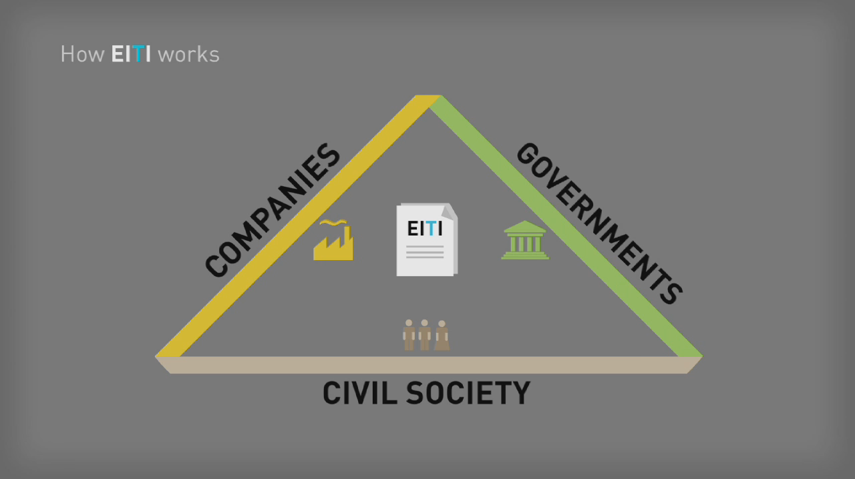
EITI: Essence and What It Entails

Slide 35
The EITI Process
Companies Disclose Payments
Government Discloses Receipt of Payments
Government Spending
Award of licenses
&
contracts
Regulation
&
monitoring of operations
Independent Verification of Tax & Royalty Payments
Revenue
Distribution
&
Management
Implement-ation of Sustainable Development Policies
Oversight by a Multi-Stakeholder Group
The EITI provides a Forum for dialogue and a Platform for broader reforms

Slide 36
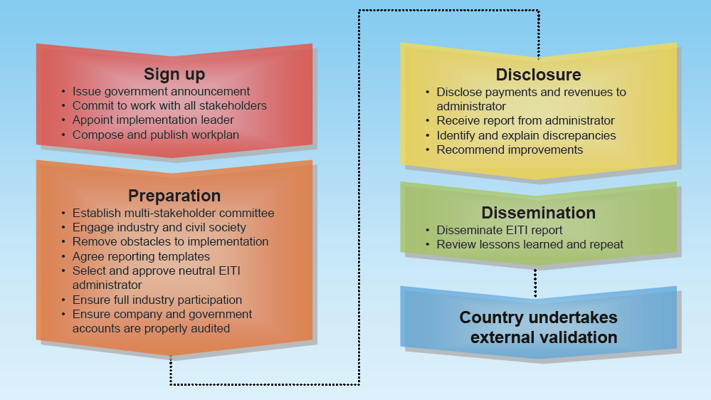
EITI Process Milestones

Slide 37
EITI: Essence and What It Entails
EITI: Governance and Support structures
Essentially voluntary initiative
Guided by Rules and Principles
Overseen by International Board
Supported by International Secretariat
Funded by Government and Development Partners (e.g. the World Bank Multi-Donor trust Fund -MDTF)
Multi-Stakeholders’ Group (MSG) composed of equal number of civil society, Government and Companies representatives
Work-plan
Memorandum of Understanding
Champion
Chairperson
Government link-institution/Ministry

Slide 38
Tanzania TEITI First Reconciliation Report: Key Issues
Tanzania acceded to implement EITI since November 2008
MSG was formed by January 2009, but started working January 2010.
Tanzania EITI reconciliation report (covering the period, July 2008-June 2009) has been compiled, and the first reconcilliation report launched on February 11, 2011.
The report contain the following key issues:
The Government indicate received less than the Companies paid in taxes and royalties
The Government MDAs (insitutions) showing major transactions deviations are Ministry of Energy and Minerals (MEM), Tanzania Revenue Authority (TRA) and Tanzania Petroleum Development Corporation (TPDC)
No moneys from EIs were paid to Treasury
Only little corporate Taxes were paid to Government
Income receivable to Government is largely workers’ statutory contributions and taxes.
Unlike the practices in many EIs rich countries such as Canada and Australia, the Companies in Tanzania do not pay Windfall Tax
One Diamond Mining Company, without reasons, did not report its payments to the Government.

Slide 39
Tanzania TEITI First Reconciliation Report: Key Issues
Nine Mining and two Gas Operations included in the reconciliation were as follows;
Bulyanhulu Gold Mine Ltd (Bulyanhulu) owned/operated by African Barrick Gold (ABG).
Pangea Minerals Ltd (Buzwagi) owned/operated by ABG.
Pangea Minerals Ltd (Tulawaka) owned/operated by ABG.
North Mara Gold Mine Ltd (North Mara) owned/operated by ABG.
Geita Gold Mine (Geita) owned/operated by AngloAshanti.
Resolute Tanzania Limited (Golden Pride) owned/operated by Resolute Mining Ltd.
Williamson Diamonds Limited (Mwadui) owned/operated by Petra Diamonds (75%) and URT State (25%).
El-Hillal Minerals Ltd (Mwadui) owned/operated by a private Company, El-Hillal.
Tanzanite One Mining Ltd (Mererani) owned/operated by a private company, Tanzania One Mining.
Songo Songo Gas operated under PSAs between TPDC (<25%) and Panafrican Energy Ltd (>75%).
Mnazi Bay Gas operated under PSAs between TPDC (<25%) and Artumas Group (>75%) -Mnazi Bay gas production.
Did not return the templates to report about its payments to Government

Slide 40
What Does the Report Tell Us?
Government received a total of Tzs 128.4billion
Companies paid Tzs 174.9 billion
Discrepancy of Tzs 46.5 billion
Mainly from
Royalty (solid minerals) = -22.3 billion
Fuel levy = -18.6 billion
Total tax revenue Tzs 62.3 billion
(excluding PAYE and NSSF) = 1.5% (tax of revenue)

Slide 41
What Does the Report Tell Us?
Transactions of Flows Reported
Taxes charged under Income Tax Act (2004)
Corporate Taxes (TzS 000)
Government confirmed receipt; 1,416,622
Companies confirmed payments; 1,270,382
Govt. over declaration effect; 146,240
Withholding Taxes (TzS 000)
Government confirmed receipt; 12,933,278
Companies confirmed payments; 14,713,153
Govt. under declaration effect; 1,779,875

Slide 42
What Does the Report Tell Us?.../
Skills & Development Levy (TzS 000)
Government confirmed receipt; 9,970,802
Companies confirmed payments; 10,263,334
Govt. under declaration effect; 292,531
Import Duties (TzS 000)
Government confirmed receipt; 4,773,743
Companies confirmed payments; 3,484,684
Govt. over declaration effect; 1,289,059

Slide 43
What Does the Report Tell Us?.../
Fuel Levy (TzS 000)
Government confirmed receipt; 0
Companies confirmed payments; 273,700
Govt. under declaration effect; 273,700
Excise Duty (TzS 000)
Government confirmed receipt; 189,195
Companies confirmed payments; 18,845,778
Govt. under declaration effect; 18,656,583

Slide 44
What Does the Report Tell Us?.../
Royalties (TzS 000)
Government confirmed receipt; 89,886
Companies confirmed payments; 393,902
Govt. under declaration effect; 304,016
Royalties (US$ 000)
Government confirmed receipt; 17,089
Companies confirmed payments; 34,136
Govt. under declaration effect; 17,047

Slide 45
What Does the Report Tell Us?.../
License and Permit Fees (TzS 000)
Government confirmed receipt; 206,068
Companies confirmed payments; 357,067
Govt. under declaration effect; 150,998
Profits as per PSA received from TPDC (TzS 000)
Government confirmed receipt; 8,121,324
Companies confirmed payments; 12,085,344
Govt. under declaration effect; 3,964,000

Slide 46
What Does the Report Tell Us?.../
Local Government Levies (TzS 000)
Government confirmed receipt; 334,683
Companies confirmed payments; 463,719
Govt. under declaration effect; 129,036
PAYE (TzS 000)
Government confirmed receipt; 45,388,519
Companies confirmed payments; 44,638,465
Govt. under declaration effect; 750,054

Slide 47
What Does the Report Tell Us?.../
NSSF (TzS 000)
Government confirmed receipt; 20,740,625
Companies confirmed payments; 20,833,926
Govt. under declaration effect; 93,301
Total Effect
Govt. under declaration taxes; TzS 24 billion
Govt. under declaration royalties; US$ 18 million

Slide 48
Emerging Issues
The total effect of confirmed Government under declared taxes and royalties, just in a period of one year only, is considered enormous! There is need to expand time scope and the Government to institute full auditing in TRA, MEM and TPDC to that effect. An Act of Parliament to backup Tanzania EITI process seems mandatory.
Coordination inadequacy: there are too many and uncoordinated points designated to receive payments from Companies, for example, MEM receives royalties, licenses & permit fees, annual rental fees and other charges; TRA receives 8 different types of taxes; TPDC receives profits as per PSAs and processed gas payments; Local Governments receive LG Levy; Treasury receives dividends on Government shares; while NSSF receive NSSF payments/contributions. In an environment where there is no effective coordination, thus kind of arrangement greatly compromises efficiency and accountability. Harmonisation of receiving collections from companies is required

Slide 49
Emerging Issues
Invisibility of Tanzanian nationals in EIs investments: the current trend is such that foreign forms of ownership/multinational corporations are dominant in Tanzania EIs investment, unfortunately also characterised by capital flight and MDAs opacity. There is need to transform current multinationals into corporate citizens of Tanzania thus meriting stakeholder’s pushing for transparency and accountability.
The corporate taxes [about 1.1% of all taxes], paid by mining and gas companies to the Government is very feeble. Most taxes are collected from workers as PAYE and similar taxes, ostensibly companies are not making profits because of carrying the initial investment charges forward thus compromising corporate profits. This may either call for renegotiating existing MDAs or reviewing MDAs with a view to rectify such anomalies for any forthcoming EIs investments.
Despite Tanzania possessing plenty of minerals, it is only gold mining that seems to dominate the scene of current EIs investments in the country, distantly followed by diamond. While this may sound as mono-mining, it is actually an opportunity for Tanzania to plan diversification of EIs investments, to get the variety of minerals in the investment docket, but cautiously observing the issues of contract transparency and accountability, and the issues noted in item 4 above.

Slide 50
Emerging Issues
It is noted in the report that during 2008/2009 period, no dividends or profits were received at the Treasury Registrar. But is also understood that the Government has shares in WDL/Petra Diamond, Songo Songo & Mnazi Bay Gas Projects; what happened? Were no profits made in those projects/investments, and therefore shareholders received no dividends? This requires back up explanations from both the Government and the Companies to the public.
Similarly, the report indicates companies paying money to the Government. It is therefore transparency imperative for the latter to explain how the received moneys were spent; indicating the distribution structure and strata. People would like to know and see priorities for which such little moneys the Government receives from mining and gas project operations are spent. In Ghana, for example, the structure and strata for distributing gold royalties; villages/chiefdoms, local governments, relevant sectors and central government/ministries are clearly known to the public and the designated recipients.

Slide 51
Emerging Issues
The wider public is not aware about what is going on with specific reference to both Tanzania EITI process and in the EIs at large. This requires such communication strategy to ensure majority, if not all Tanzanians, are aware about current extractive industries types and stock levels, operators, fiscal aspects of EIs as well as environmental and human rights issues relevant to EIs activities in the country. To that effect, the Government should address systemic good governance barriers of corruption; the Parliament (and even individual parliamentarians) should be properly informed about EIs operations in the country; the Government should consider to institute the designate EIs revenue oversight arrangement while strengthening the existing institutional framework for EIs monitoring; an oversight role of Tanzania EITI be given legal mandate (backup); the interfaith, civil society, and lobby groups such as Tanzania Chamber of Commerce Industry and Agriculture (TCCIA), Tanzania Private Sector Foundation (TPSF), Tanzania Business Council (TBC), Confederation of Tanzania Industrialists (CTI), and the media should devise the strategy to work together to champion Tanzania’s extractive industries new charter and vision for national development.

Slide 52
Moving Away from Transparency to Accountability
Rationale
The Revenue Emphasis model has failed:
A number of extractive industries studies trying to establish resounding link between extractive industries production and improvement in the economies and social well being, conducted and occasionally published by WB, IMF, or bilateral Development Partners’ institutions (NORAD and others), have indicated stunning results.
A recent report titled Tanzania Investments Benefits Study (Sustainable Management of Minerals Resources Project) published by Ministry of Energy and Minerals (Tanzania) shows during 2004 -2010, the large scale gold mining companies paid income tax not exceeding $ 12.5 million, of which the projects owned by African Barrick Gold (BAG) did not pay any corporate tax. The same report also indicates people living in mining areas are not satisfied and consider themselves to have not benefitted from large scale mining investments in the country. http://www.opml.co.uk/sites/opml/files/Investment%20Benefits%20Report%20for%20MEM.pdf
Another report published by World Bank and World Gold Council (WGC) indicates during 2007 - 2010 period, Tanzania (mining companies) exported gold worth US$ 1.508 billion, from which the Government of Tanzania earned $ 78 million only.

Slide 53
Way Forward: EATUC
Strategies:
EITI Reform Agenda (Campaigning for Extractive Industries value chain transparency)
Budget Transparency campaign
Community License
Contract transparency
Africa Mining Vision (AMV)
Integrating AMV through EAC (Policy Harmonisation)/SADC

Slide 54
End
Thanks
pwyptanzania@fordia.org
Bubelwa.kaiza@fordia.org

